Slide 1

Employee Salary Prediction System

Slide 2

Meet The Query Troop
IT22109712 - Fonseka W S M
IT22071934 - Rajana H T R
IT22071316 - Shahaam M
IT22891204 - Wickramaratne A J S de Z
IT22918192 - Rathnayake S J
Notes:
Our team of data detectives is here to uncover the insights hidden in your data Let me introduce you to the key members of this skilled squad: John Doe is our passionate data scientist, with a strong foundation in statistical modeling Jane Smith excels at data preprocessing and feature engineering, ensuring the quality of our data Michael Brown brings expertise in machine learning algorithms and model selection Emily Davis focuses on data visualization and communication, presenting insights clearly and impactfully David Wilson is responsible for deploying and maintaining our prediction system, ensuring it's accessible and efficient Together, this balanced team of data experts is ready to tackle your toughest data challenges

Slide 3
Background
Salary prediction is essential for fair compensation and workforce planning.
Analyzing data on factors such as age and education allows us to predict salary outcomes.
Accurate predictions enable effective compensation strategies and inform employee expectations.
Data-driven insights support informed decisions for both employers and employees in the evolving job market.

Slide 4








Technologies
Python
Sci-kit Learn
NumPy
Matplotlib
Pandas
Flask
HTML
Bootstrap

Slide 5

Target & Business Goal
Target
To create a precise predictive analytics model for forecasting salary outcomes based on employee attributes.
Business Goal
To enhance compensation strategies and improve employee satisfaction, contributing to talent retention and overall business growth.

Slide 6

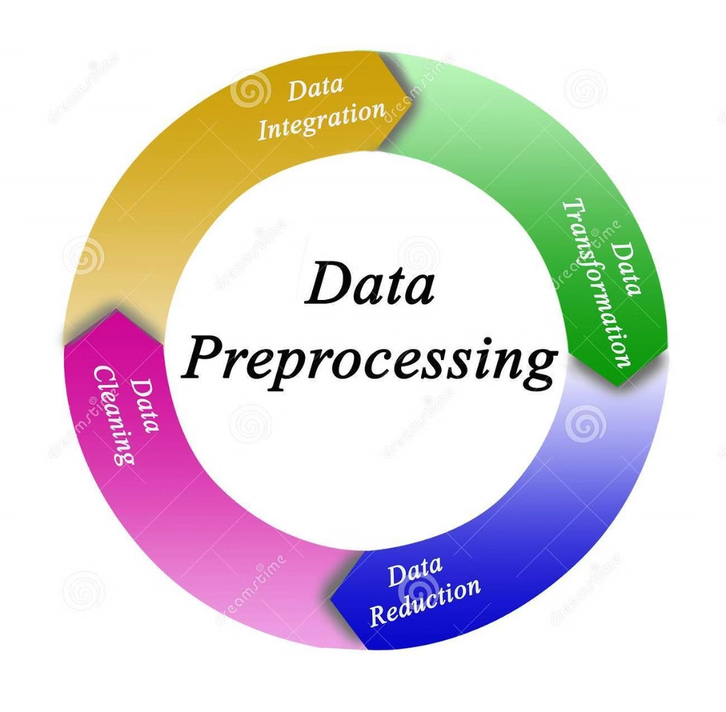
Data preprocessing

Slide 7
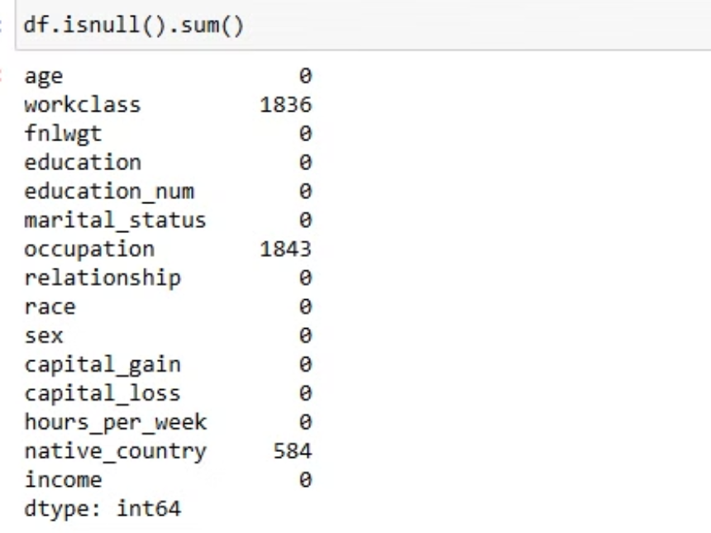
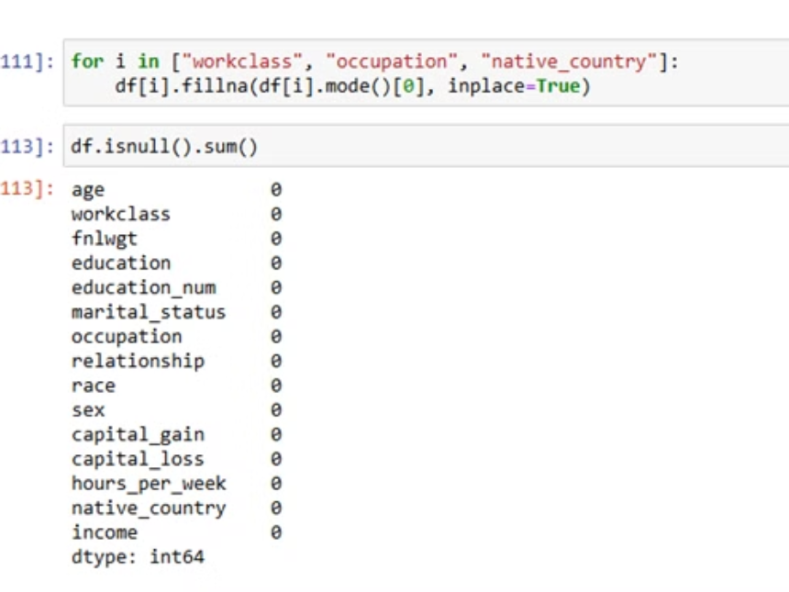
Handling Null Values
1)find null values 2)Filing missed values with mode

Slide 8
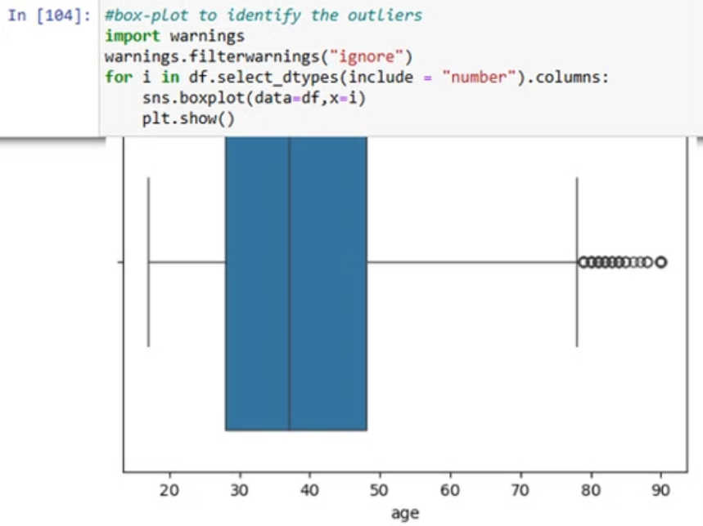
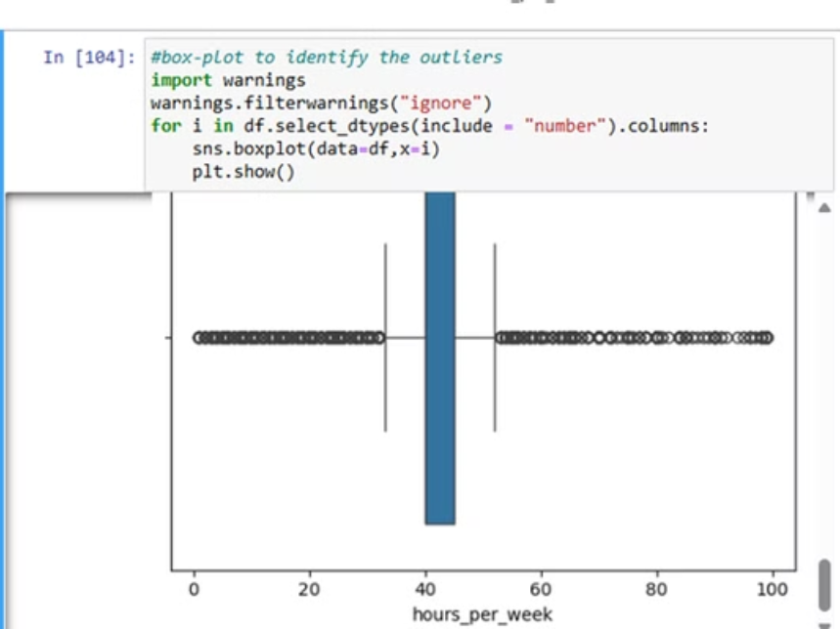
Handling Outliers

Slide 9
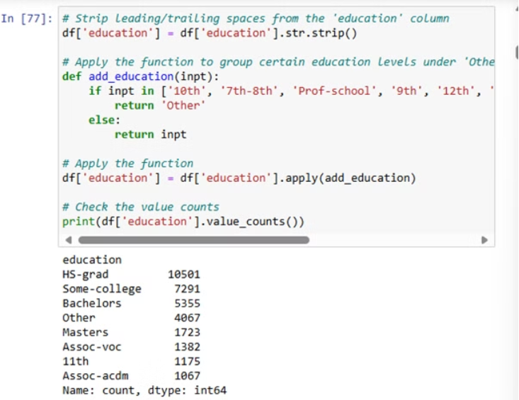
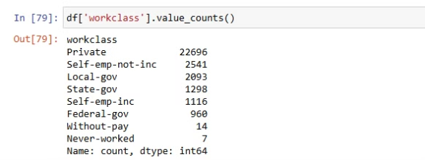
Data Transform
We grouped the following features into unique categories to reduce the number of unique entries in the dataset: education, work class, marital status, occupation, race, relationship, and native country.

Slide 10
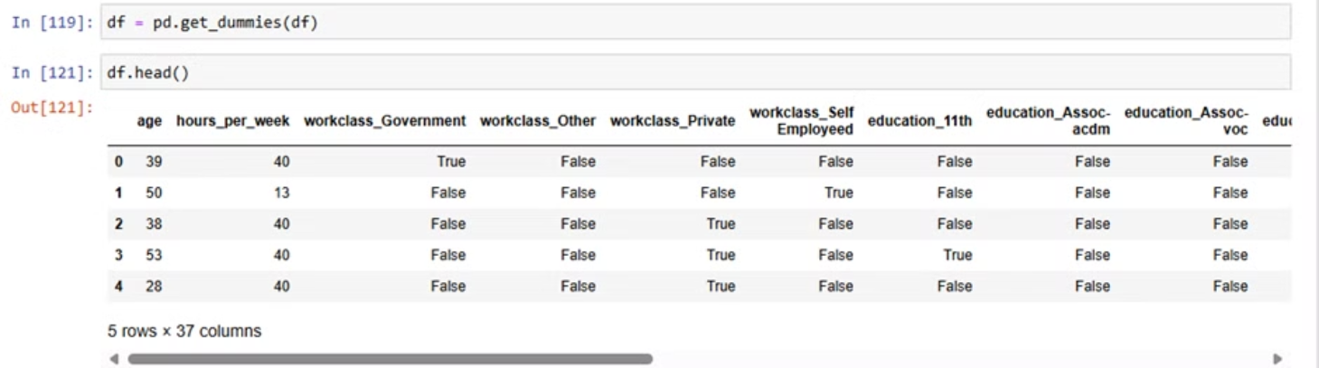
Encoding Categorical Features

Slide 11

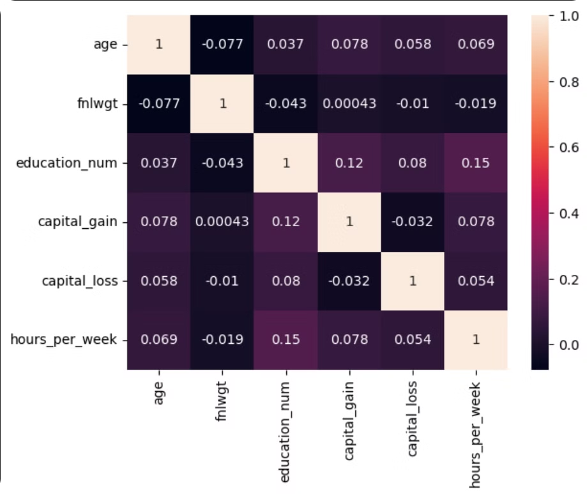
Correlation Matrix

Slide 12
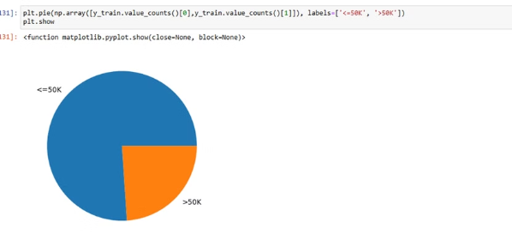
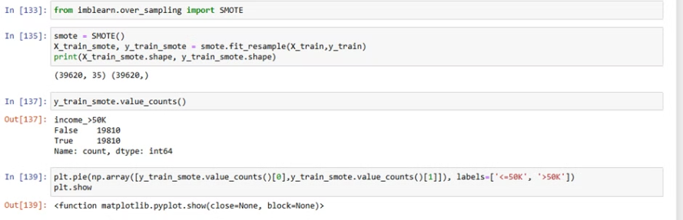
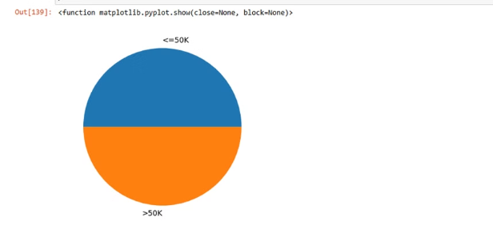
Balance the Dataset

Slide 13

Model Implementation

Slide 14
Model Implementation
We used five different models here to predict the customer churn or not.
Linear Regression
Random Forest Decision Tree
Classification
Naïve Bayes Classification
Support Vector Classification
2. The Random Forest Model was selected as the most effective in terms of predictive performance.

Slide 15
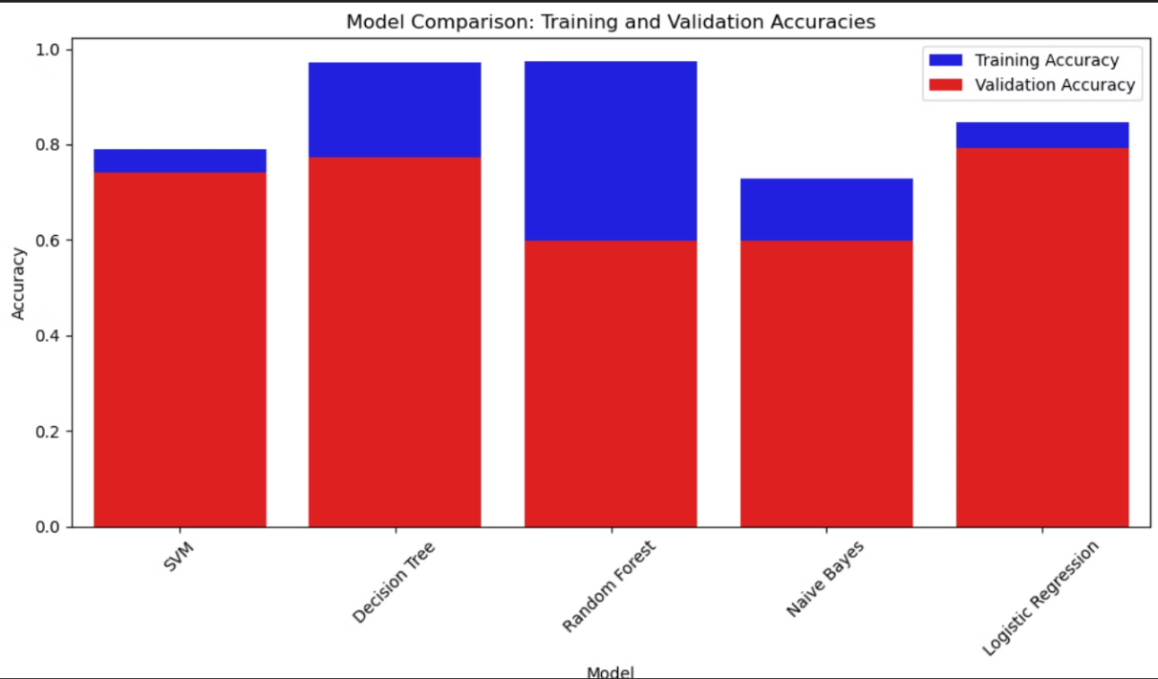

Slide 16
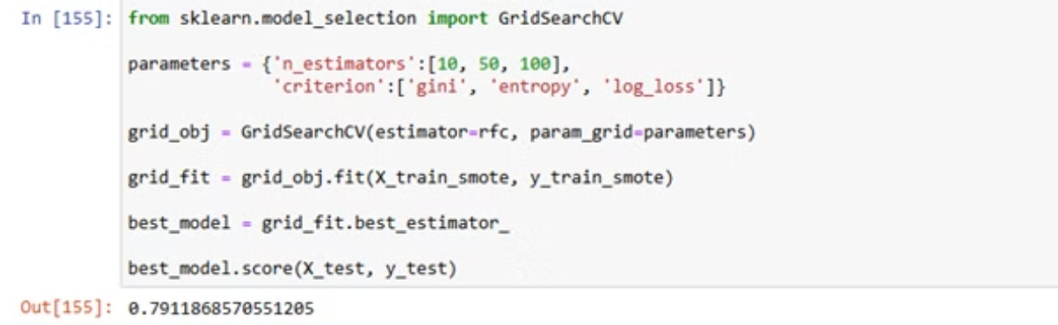
Improving the Accuracy
Improving best model by hyperparameter tuning

Slide 17
Final Product
Employee Salary Prediction System

Slide 18
Challenges
Solutions
Poor data quality can result in inaccurate salary predictions.
Clean and validate data for accuracy.
Apply SMOTE to balance classes.
Certain groups may be underrepresented, causing class imbalance.
Experiment with models like logistic regression and random forests.
Electing the right machine learning model is essential for accurate predictions.
Select the model with the best performance.

Slide 19
Further implementations and developing goals
1. Modify the system to position it as a marketable product.
2. Develop a product tailored to the Sri Lankan job market.
3. Ensure the system addresses the unique dynamics of rapid salary fluctuations in various sectors.

Slide 20
THANK YOU!

